Slide 1

OM APIs for a Social OS
Ben Dodson
Omlet Inc
Stanford, April 1, 2015

Slide 2
Overview
Contextual Apps
OM Data Model
Android Service Components
APIs for Data and Group Management
Social Gallery

Slide 3
Types of Apps
In-chat sharing (appLETs)
Simple, lightweight sharing
Share rich media types in chat
Games
Turn-based, High Score, Challenge
Native apps
Use OM service infrastructure Android API bindings
Partners-only access to user data and social graph
Cloud-based publishing services
A cloud service adds a bot to a chat
Read/write access

Slide 4
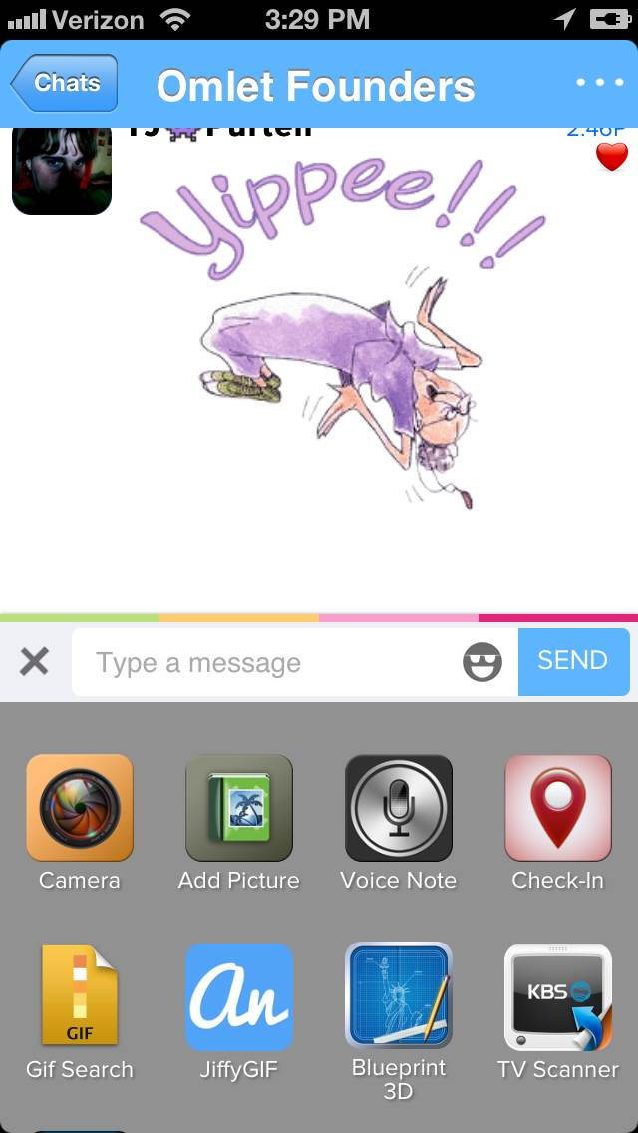
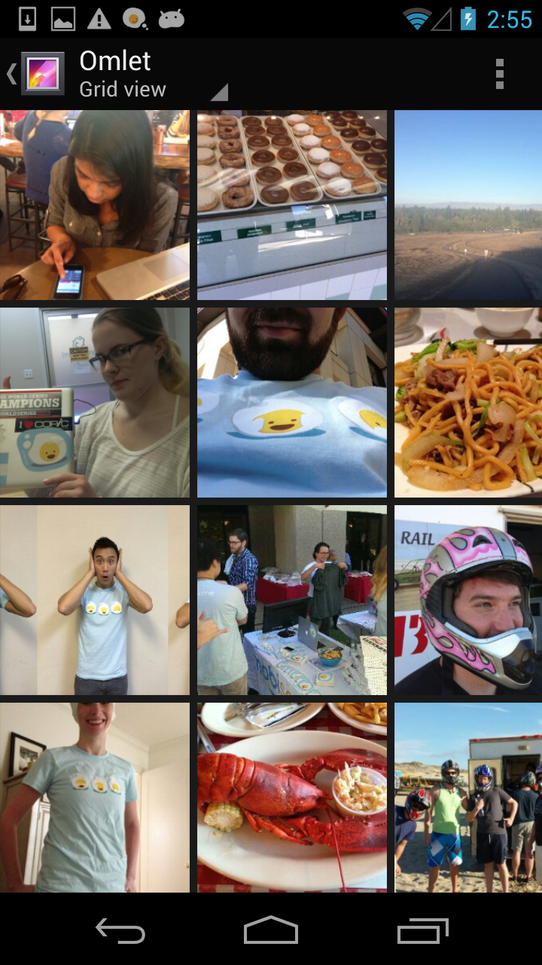
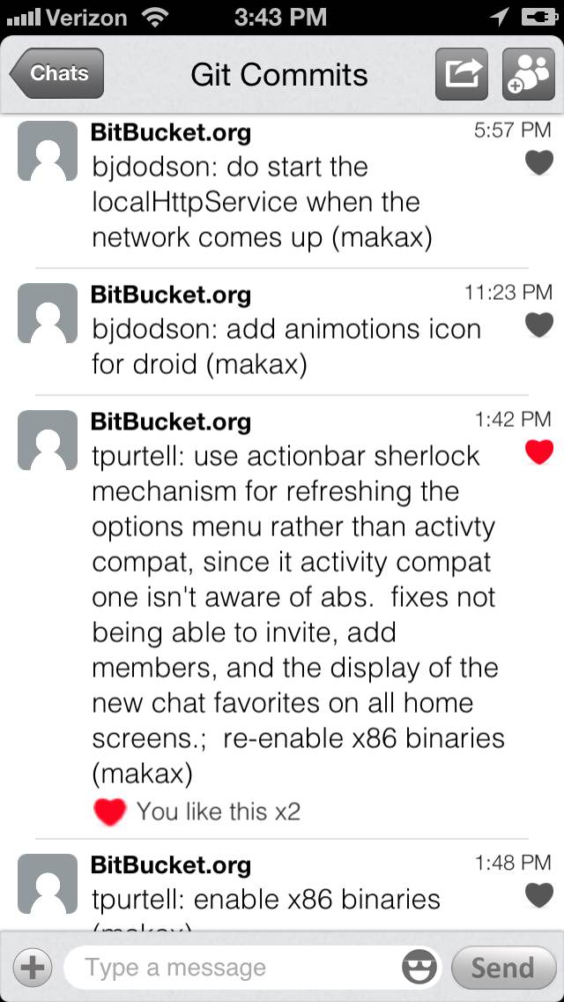
Types of Apps
In-chat Sharing
Groups in App
Cloud Service

Slide 5
In-Chat Sharing: Data Types
Omlet supports a variety of media types
Text, Links, Pictures, Audio, Locations, and Animated GIFs
Video files
MIME Files
Custom per-app types

Slide 6
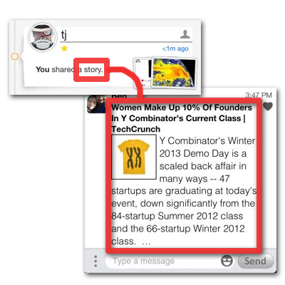
Rich Deep Link
Rich Deep Link data format
Human-readable type
Text and/or picture for display
Package name
Launch URL
Web fallback URL
Json argument

Slide 7
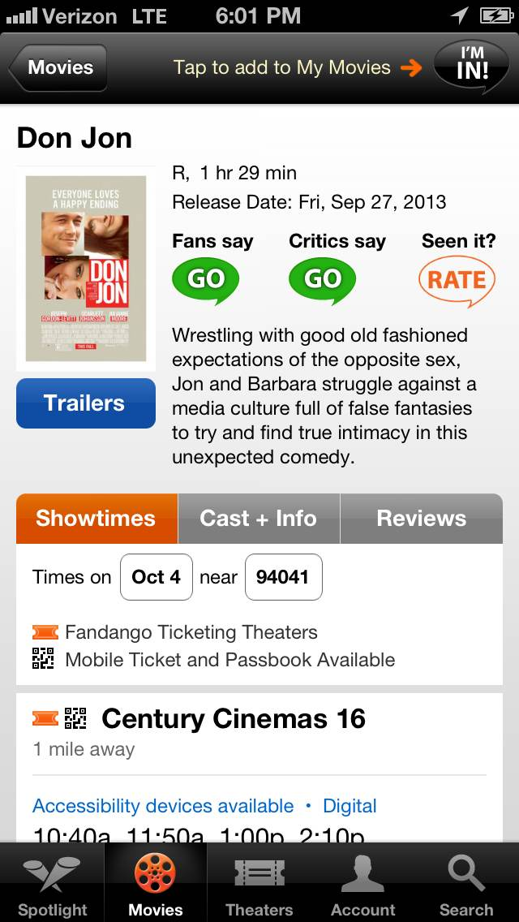
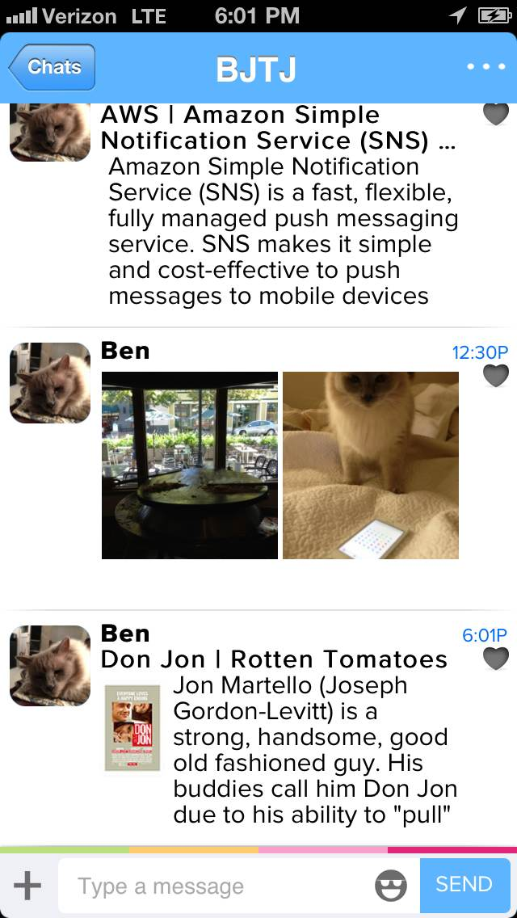
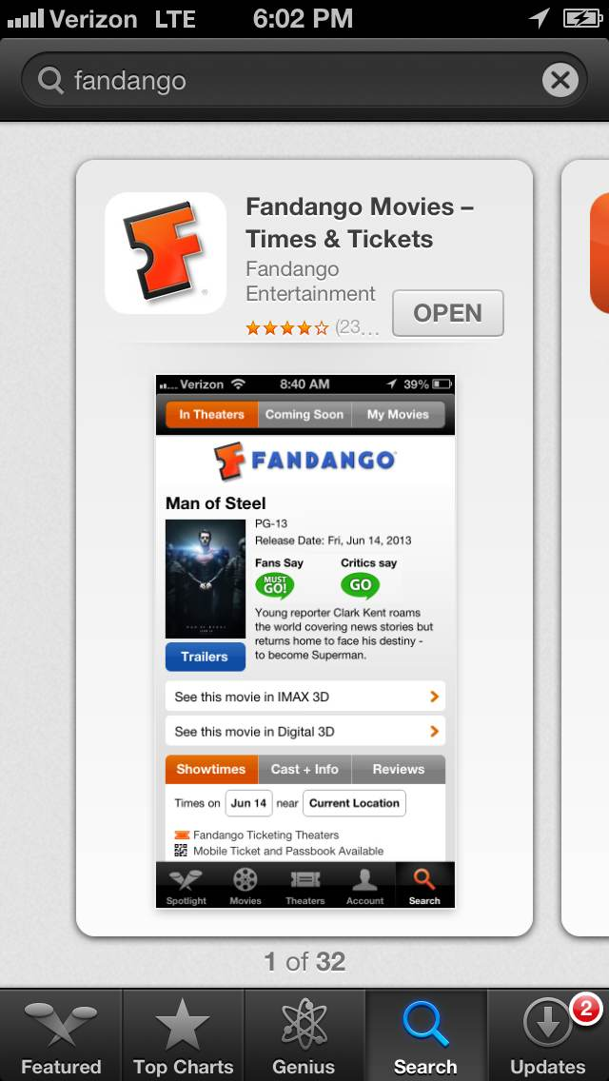
Android Apps: SEND intent
Use Android’s SEND or SEND_MULTIPLE intent to send any supported data type (RDL recommended)

Slide 8
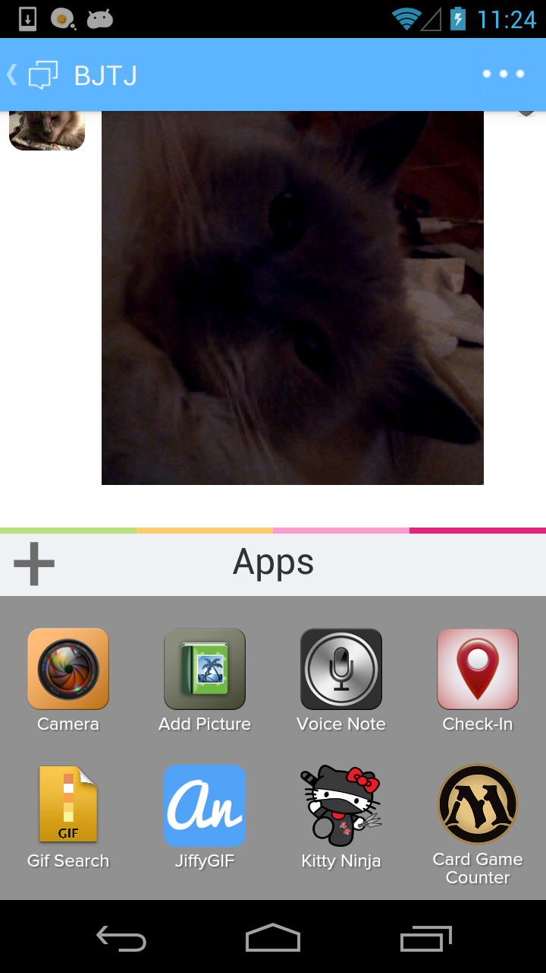
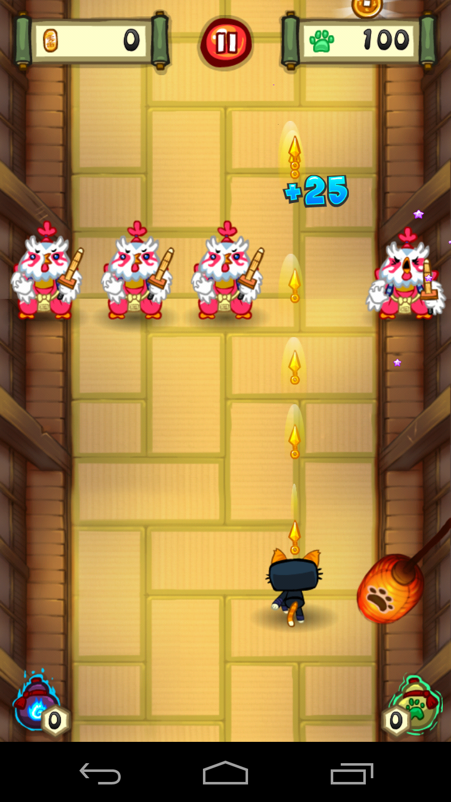
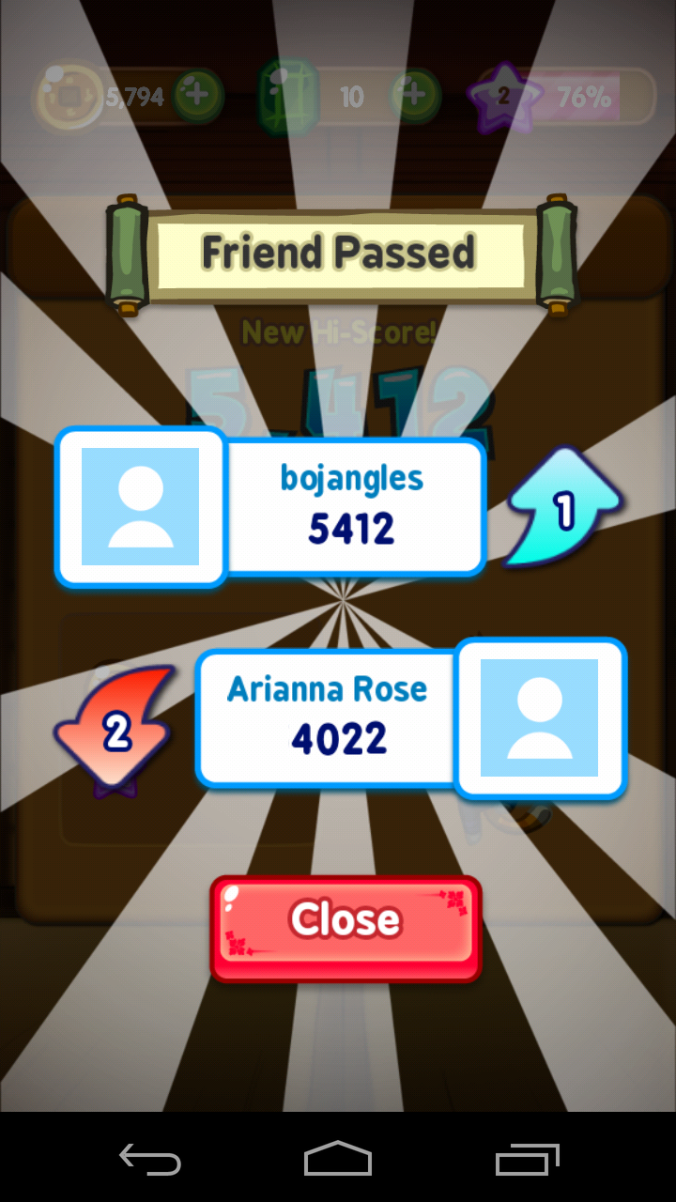
Contextual Apps: Drawer Apps

Slide 9
Contextual Apps: Drawer Apps
App launched from conversation’s “app drawer”
Handle intent mobisocial.intent.action.LAUNCH to be listed
Launch intent includes reference to feed
Set a result to post data into the chat
App can query for feed details (members, data, etc)
Post content of any supported type

Slide 10
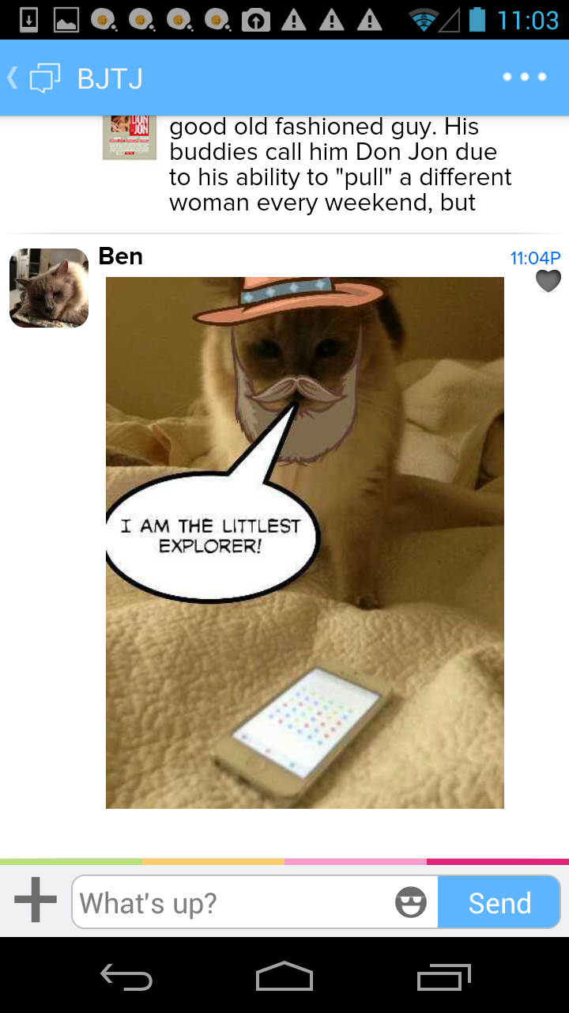
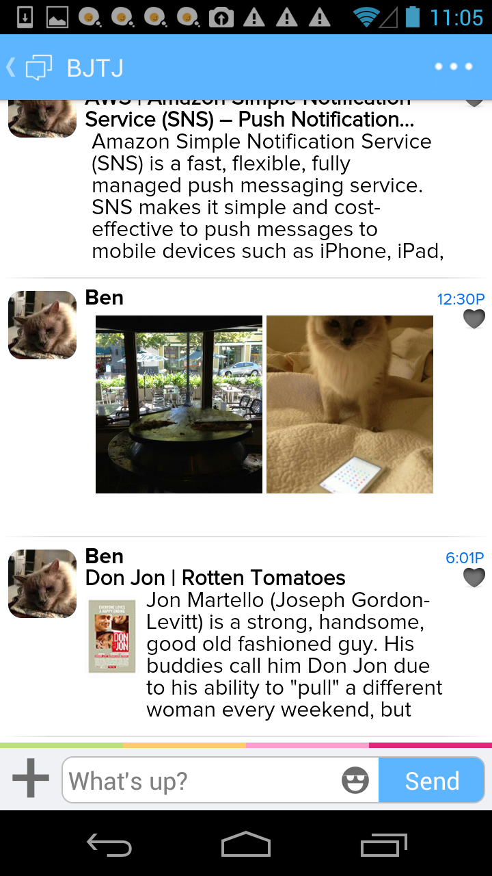
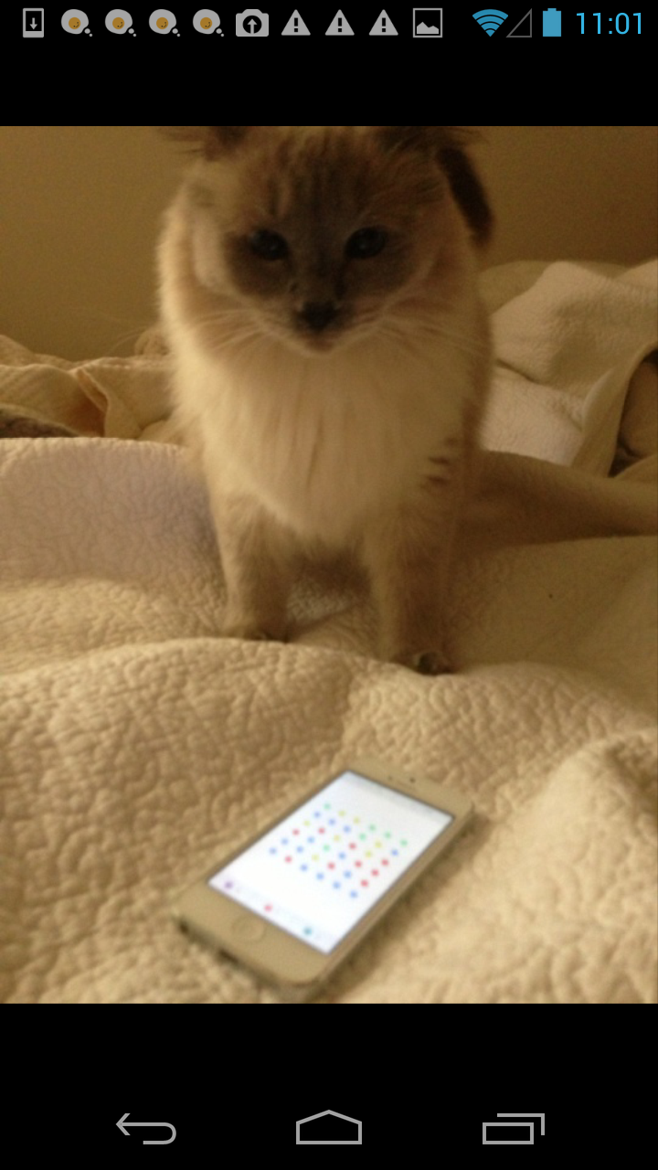
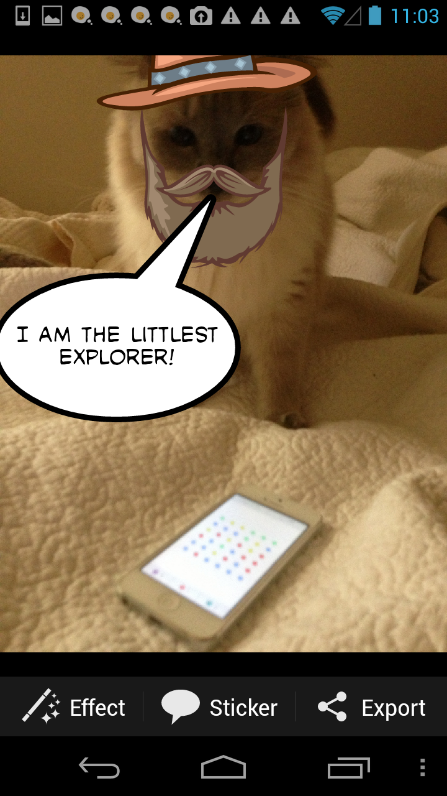
Contextual Apps: Editor Apps
Emphasis on fun social editors

Slide 11
Contextual Apps: Editor Apps
Android has an EDIT intent, but it does not return the edited picture back to the caller!
App is launched from a picture
Handle intent android.intent.action.EDIT
Category mobisocial.intent.category.IN_PLACE
Set a result to return edited picture to the caller
Save result at the original file location
Set file uri as result data
Result code OK (or cancel if appropriate)

Slide 12
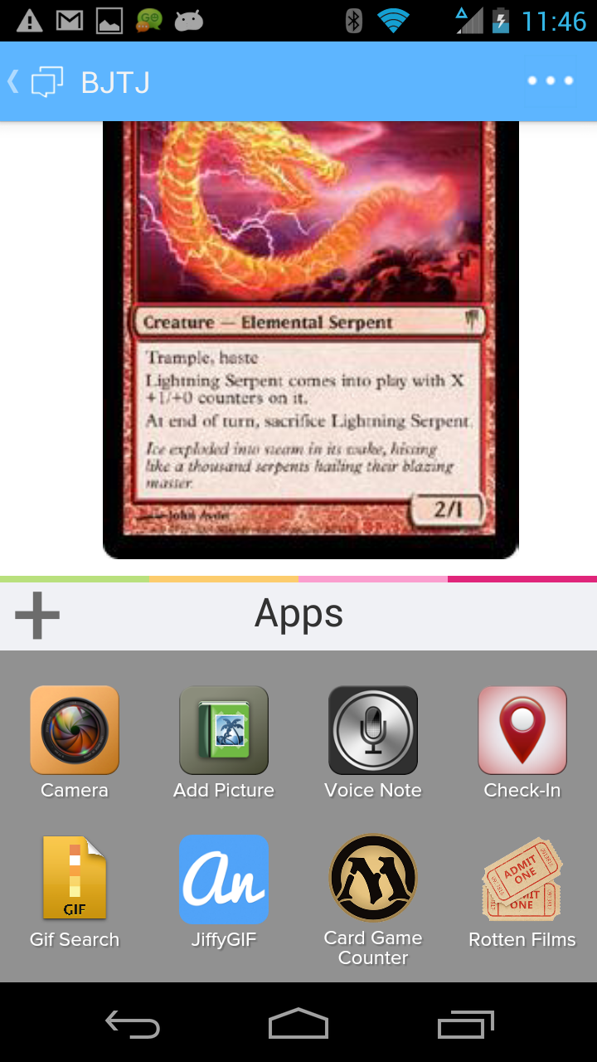
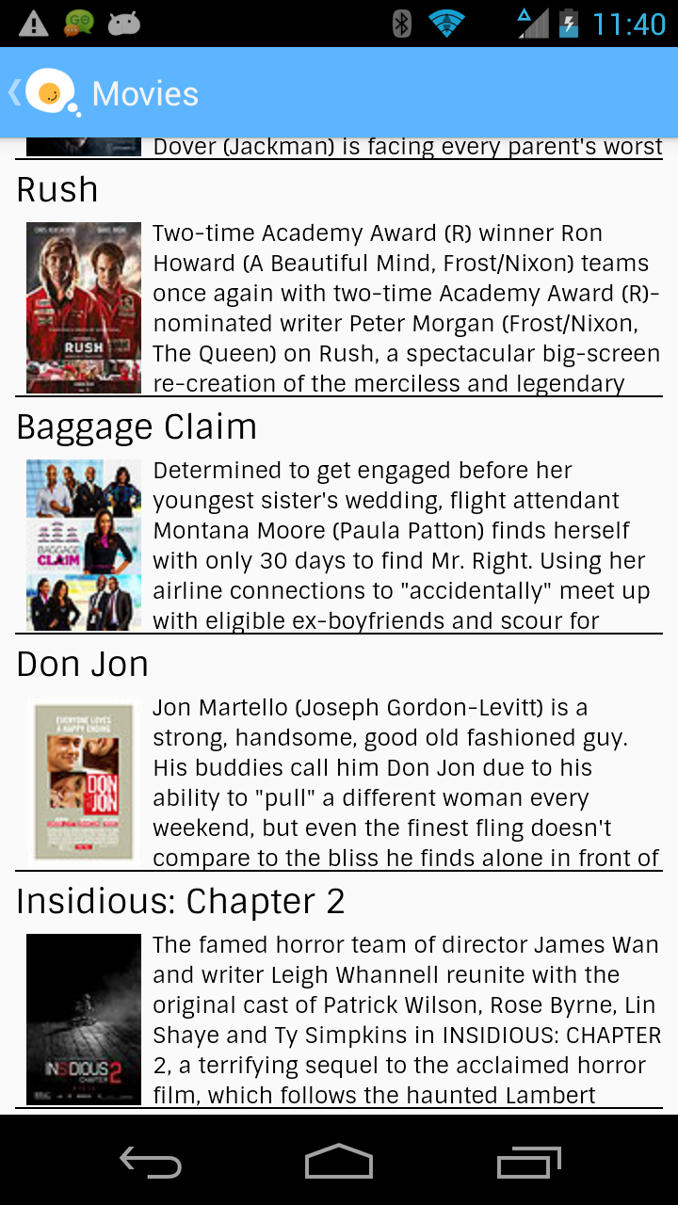
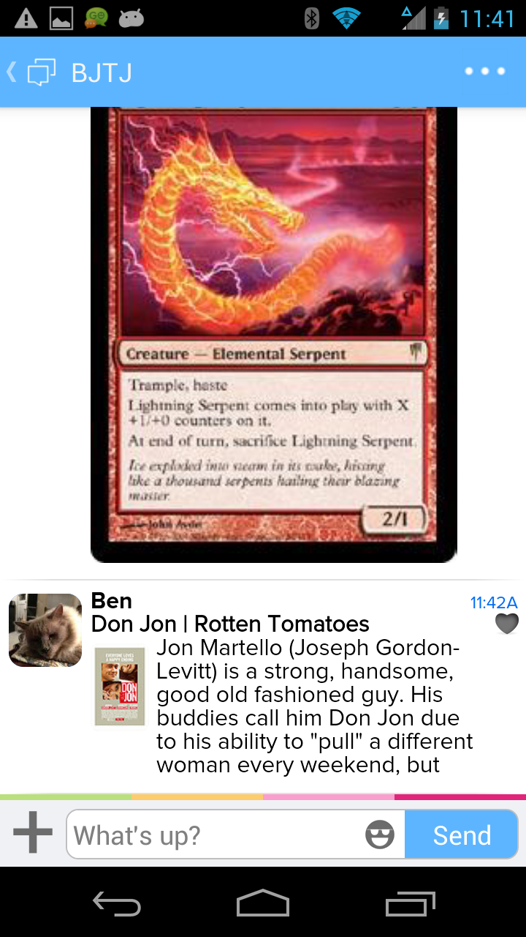
HTML Apps

Slide 13
Games
Classes of games
Turn-based
High Score
Challenge

Slide 14
Initiating a Challenge
Omlet
O2Jam
1. User selects O2Jam from Omlet
2. User initiates challenge flow
3. Omlet calls out to O2Jam
new Intent (“com.momocorp.o2jamu”);
intent.addCategory(“mobisocial.intent.category.CHALLENGE”)
intent.putExtra(“mobisocial.intent.extra.CHALLENGE_TOKEN”, stringToken)
4. User picks a song
5. User plays that song
6. O2Jam calls back to Omlet with score and song info
new Intent (“mobisocial.intent.action.FINISH_CHALLENGE)
intent.putExtra(“mobisocial.intent.extra.CHALLENGE_TOKEN”, stringToken)
intent.putExtra(“mobisocial.intent.extra.GAME_SCORE”, longGameScore)
intent.putExtra(“mobisocial.intent.extra.CHALLENGE_DATA”, stringSongId)
7. Omlet sends challenge to opponent

Slide 15
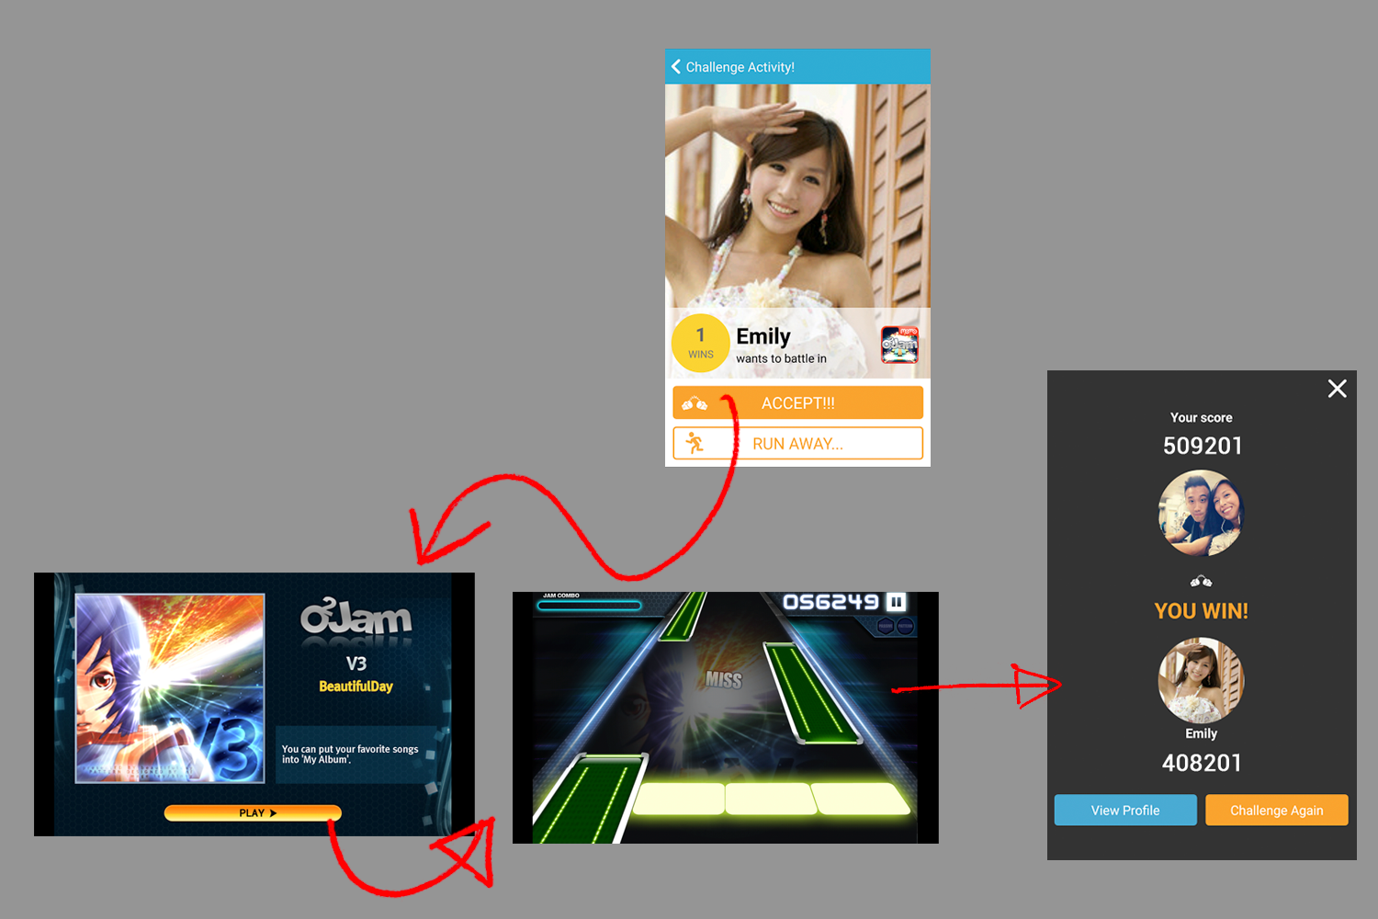

Slide 16
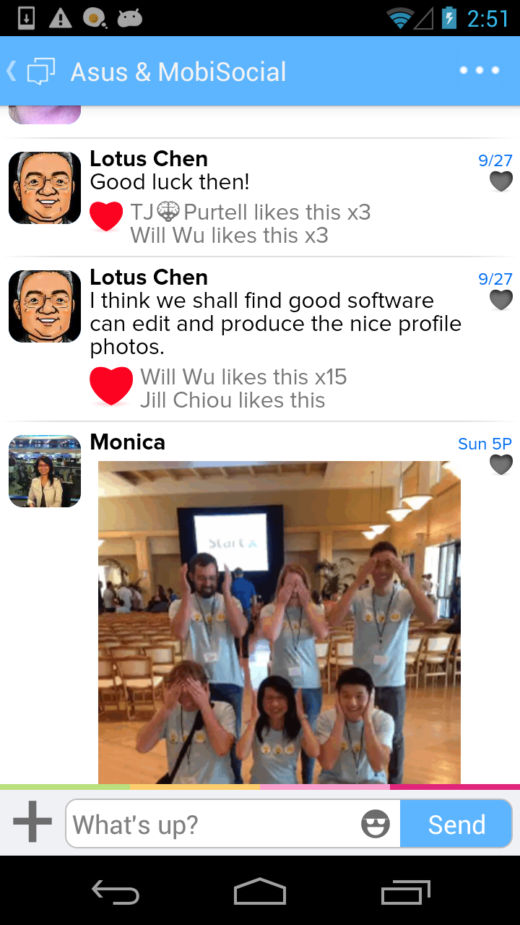
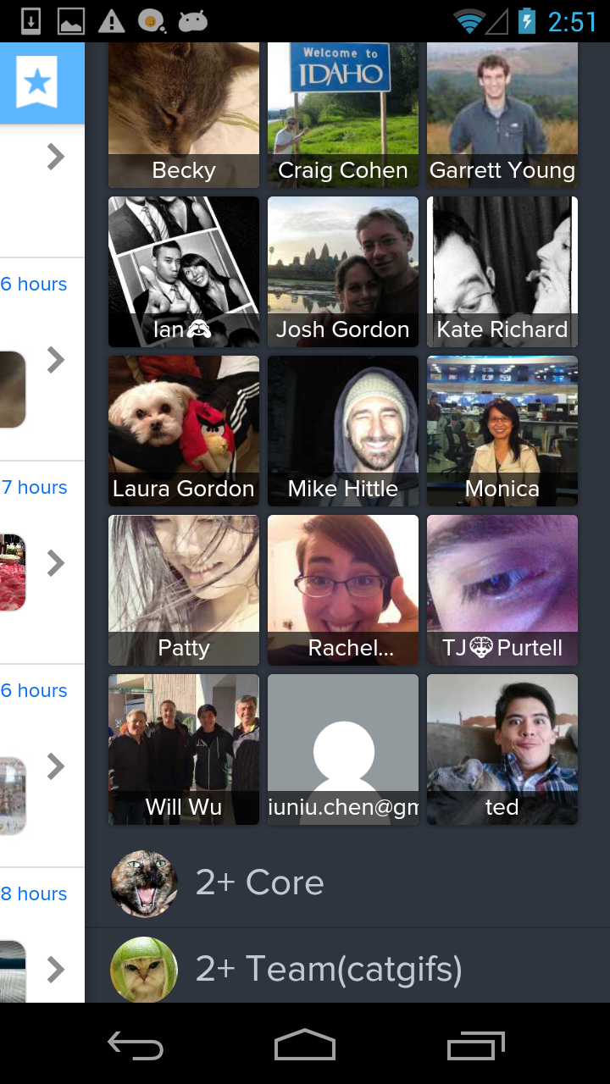
Bringing Groups and Data to Apps
Feeds are more than “chats”.

Slide 17
OM Data Model
Feeds
An access-controlled collection of users and data
Identities
Represent users identified by an email, phone number, or other claimed identifier
Objects
Typed data shared within a feed. Each object has its own unique identifier, a sender, and timestamp, and a collection of type-specific fields.

Slide 18
Data Synchronization
Objects are pushed directly to devices
When not active in the app, use GCM when possible, alternatively can use OM persistent connection
Objects are small and immutable
Typically < 4KB
Can be deleted
Blobs are attached to objects by their hash
Example: PictureObj references a thumbnaiHash and fullsizeHash

Slide 19
Example: PictureObj
{
type: “picture”
universalId: “bsf9b6fs998sd7f9g8sdggs“
feed: “7b412c8bc3599d1149f07f540f7f76cd“
sender: [“email:ben@mobisocial.us“,““]
timestamp: 1380932389832,
thumbnailHash: “9d48dc9a1ee2bd97749db6c7cc7”,
fullsizeHash: “08b7a3dc5c2f720562c0d01cee6”,
fullsizeWidth: 1280,
fullsizeHeight: 960,
latitude: 37.4252895,
longitude: -122.139099
serverTimestamp: 1380932393329
}

Slide 20
Android Service Hooks
Content Provider
Service
Intents and Activities

Slide 21
Content Provider
Provides read-only access to feeds, identities, and objects
content://mobisocial.osm/<TABLE>
/feeds, /identities, /members, /objects, /feeds/<ID>
Notifications when datasets change
getContentResolver().registerContentObserver(
Uri.parse(“content://mobisocial.osm/feeds/238”), true, null);
Asynchronously read blob data
getContentResolver().openInputStream(blobUri);
Secured via whitelist– we provide access to a fixed set of Android package identifiers.

Slide 22
Service
BindService for long-lasting service connections
Register a Messenger to get the stream of received objects
Get the current list of Hotspots
StartService for write-access to user data
Post data to a feed
Delete an object

Slide 23
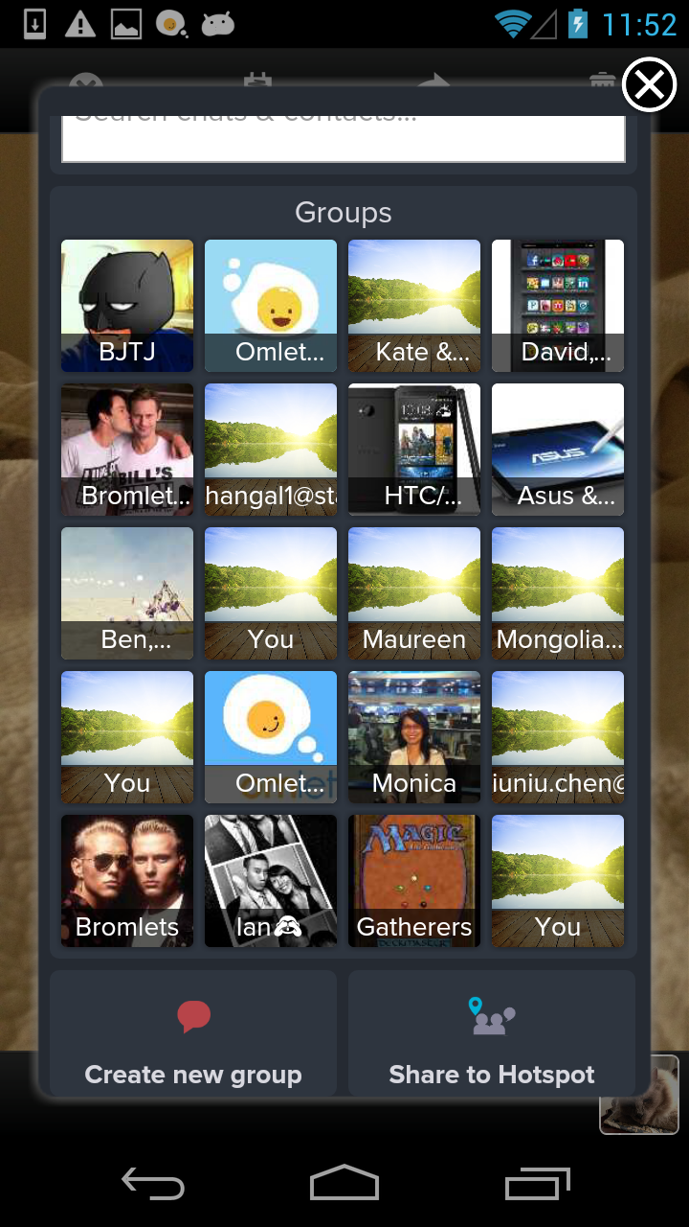
Intents-for-Result
Provides UI for accessing or modifying feed data
Pick a group (picker)
Delete a group (yes/no)
Share to a group (SEND / SEND_MULTIPLE)
Can also list all other apps that can be used for sharing
Add members to a group
Join or create a Hotspot

Slide 24
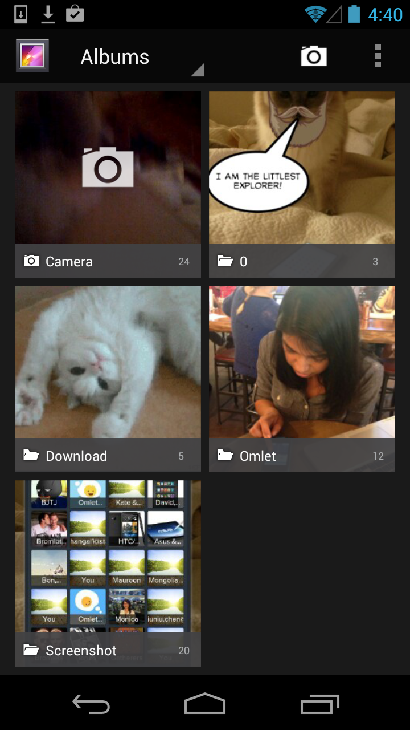
Putting it All Together: Social Gallery
Albums are Feeds
Pictures are Objects
Access control using Identities

Slide 25
Social Gallery: List Albums
Query for feeds with pictures in the Content Provider
String[] projection = new String[]
{ "Id", "Name", "ThumbnailHash", "Favorite", "Picture1Id" };
String selection = "expired=0";
String[] selectionArgs = null;
String sort = "renderableTime DESC";
Cursor a = getContentResolver().query("content://mobisocial.osm/feeds", projection, selection, selectionArgs, sort);

Slide 26
Social Gallery: Create an Album
Use a service connection to create a feed
Uri albumUri = omService.createControlFeed ();

Slide 27
Social Gallery: Add People to an Album
Use an intent to invoke the “Add Members” dialog
Intent prompt =
new Intent("mobisocial.intent.action.ADD_MEMBERS");
prompt.putExtra("mobisocial.intent.extra.FEED_URI", albumUri);
startActivityForResult(prompt);

Slide 28
Social Gallery: List Album Participants
Query the content provider for the album’s feed members
long feedId = album.getLong(0);
Uri uri = Uri.parse("content://mobisocial.osm/members/" + feedId);
String[] projection = new String[]
{ "Id", "Identifier", "Name",
"ThumbnailHash", "HasApp", "Favorite" };
String selection = null;
String[] selectionArgs = null;
String sort = "name DESC";
Cursor m = getContentResolver().query(uri, projection, selection,
selectionArgs, sort);

Slide 29
Social Gallery: List Photos
Query for picture objects in the Content Provider
Uri uri = Uri.parse("content://mobisocial.osm/feeds/" + feedId);
String[] projection = new String[]
{ "Id", ThumbnailHash", "FullsizeHash",
"ServerTimestamp", "SenderId" };
String selection = "type='picture'";
String[] selectionArgs = null;
String sort = "ServerTimestamp DESC";
Cursor p = getContentResolver().query(uri, projection, selection, selectionArgs, sort);

Slide 30
Fetch a photo’s thumbnail or fullsize image
Use the ContentResolver to get a file descriptor
File may not yet exist locally
byte[] hash = p.getBlob(1);
Uri uri = Uri.parse("content://mobisocial.osm/blobs/" +
hexEncode(hash));
InputStream stream =
getContentResolver().openInputStream(uri);
/* or */
ParcelFileDescriptor file =
getContentResolver().openFileDescriptor(uri, mode);

Slide 31
Build with us!
http://www.omlet.me/developers

